Slide 1
Multiple Regression SPSS
Restaurant. Sav -Advertising example
Notes:
Contact Information: Ann Thapar
0205 036 6592
a.puri@westminster.ac.uk

Slide 2
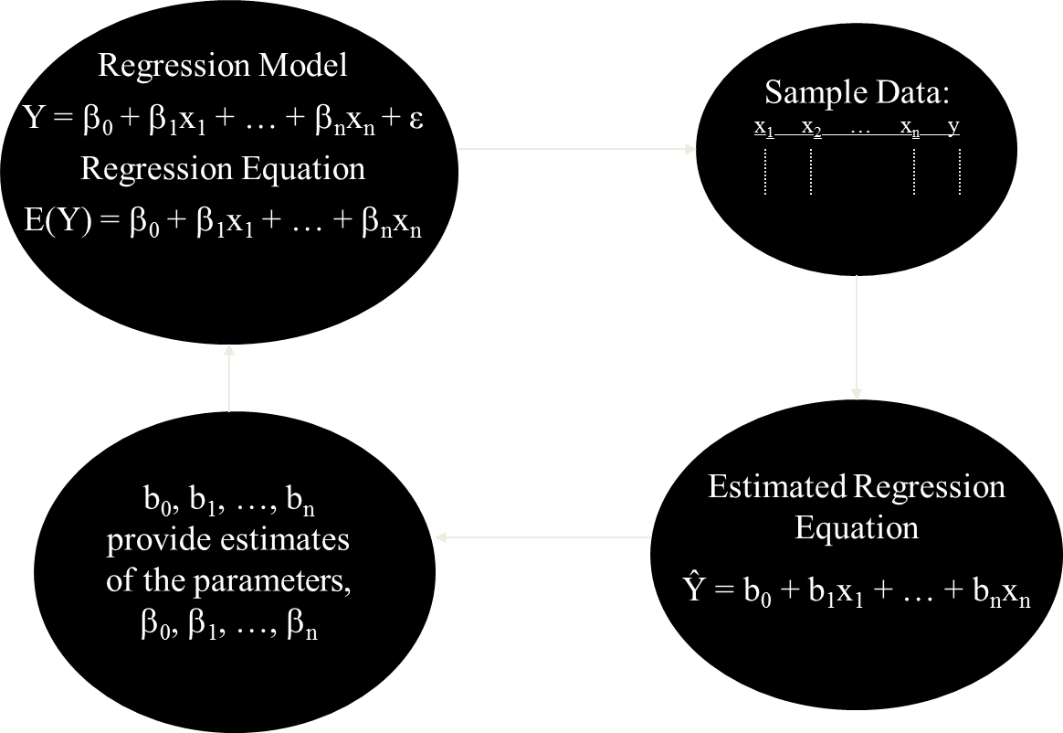
Process for Multiple Regression
Notes:
The only change from what we had before is that we have more independent variables
Still only one dependent variable
Still want estimates of population parameters

Slide 3
Interpretation of the Coefficients
Ŷ = b₀ + b₁X₁ + b₂X₂ + … + b_{n}X_{n}
Interpretation
b₀
Expected value of Y when all X’s equal 0
Other slope parameters (b_{i}’s)
Change in Y when X_{i} changes by 1 unit
And “the other X’s remain constant”
This Extra Proviso very important
Estimates of b_{i}’s depend on which X’s are included
Notes:
b₀
Expected value of Y when all X’s equal 0
Sometimes this interpretation of b₀ does not make sense
Appropriate when all X_{i}’s=0 is possible
Can be an artifact of calculations – used to anchor line
Other slope parameters (b_{i}’s)
Change in Y when X_{i} changes by 1 unit
And “the other X’s remain constant”
This Extra Proviso very important
Estimates of b_{i}’s depend on which X’s are included

Slide 4
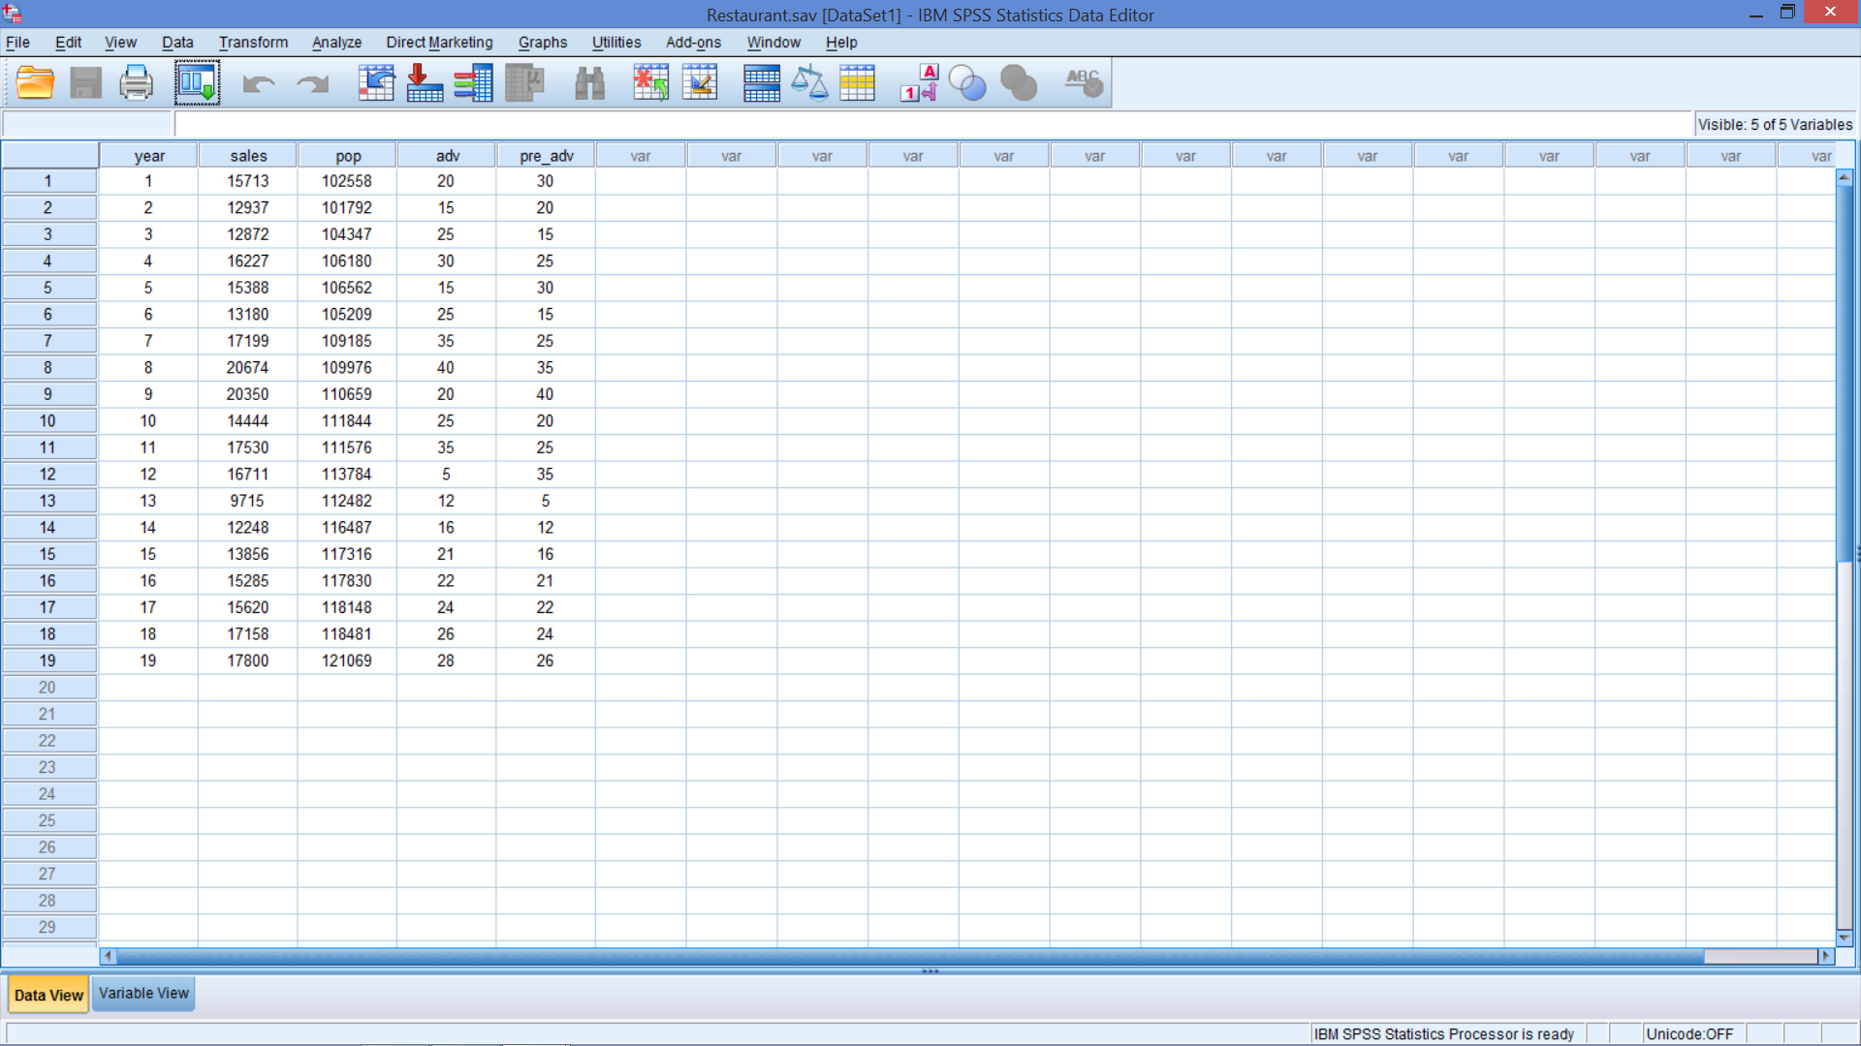
Open Restaurant.sav in SPSS

Slide 5
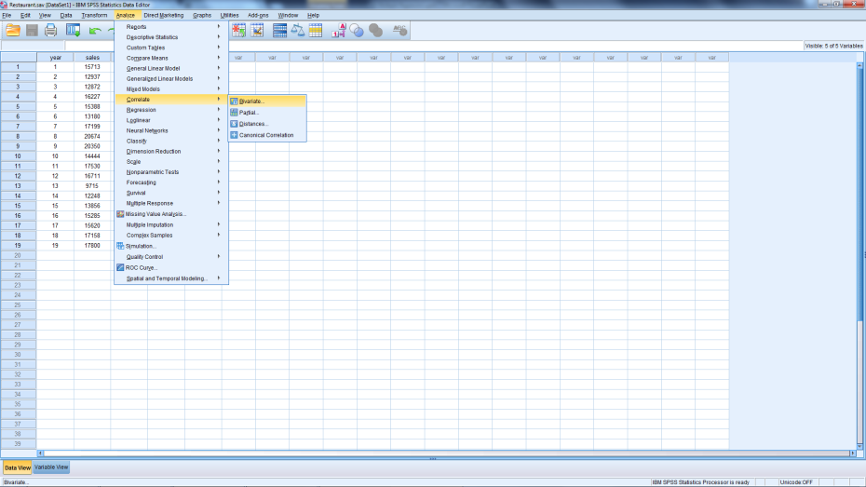
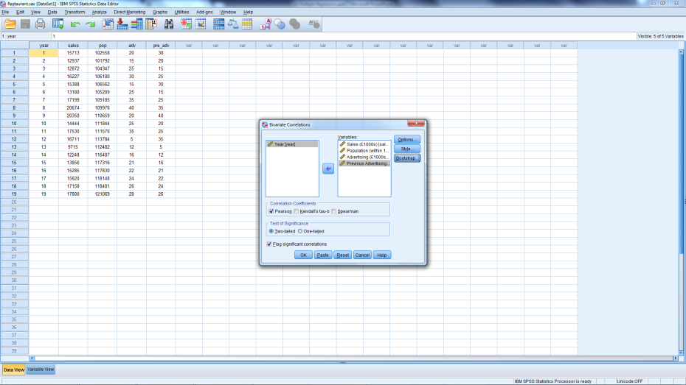
Recreate Correlations Table
Notes:
Analzye → Correlate → Bivariate
Select Sales, Population, Advertising, & Previous Advertising for Variables
OK

Slide 6
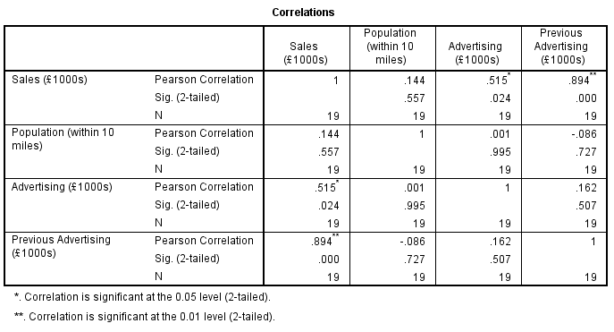
Looks Familiar

Slide 7
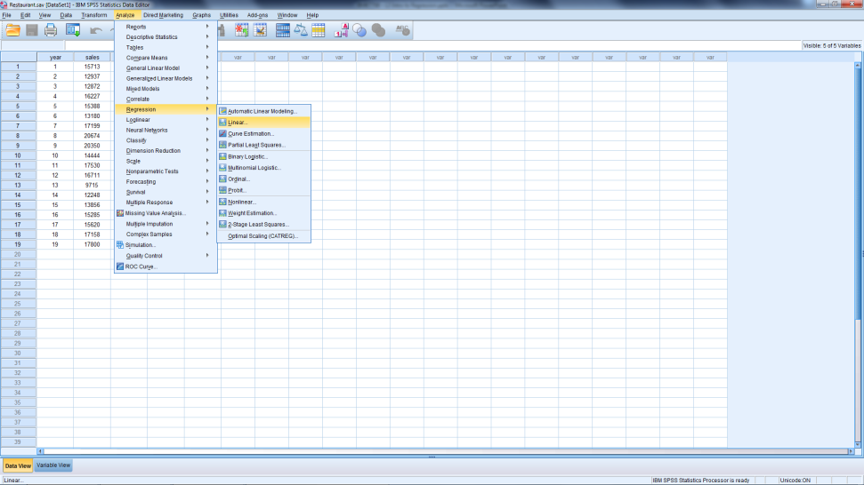
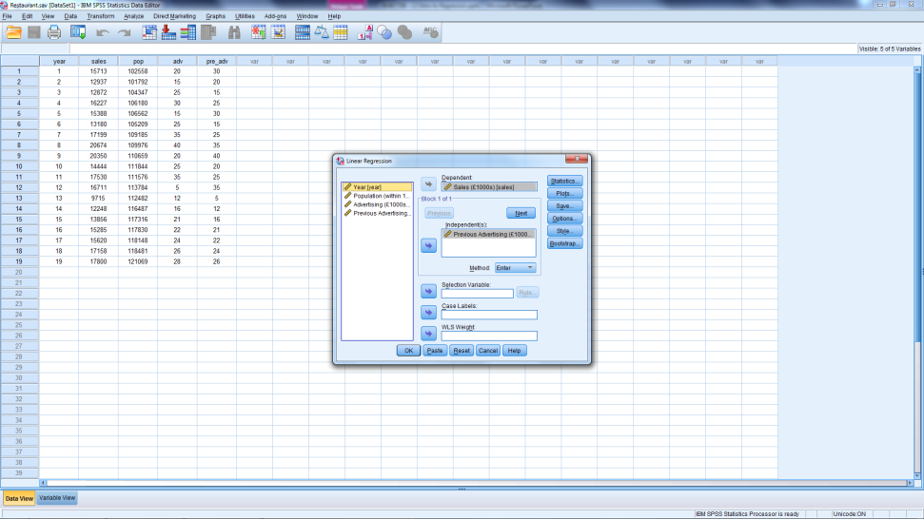
Create Simple Regression
Notes:
Analyze
Regression → Linear
Specify Model w/ arrows
Dependent variable
Sales
Independent variable
Previous Advertising
Method = Enter
OK

Slide 8
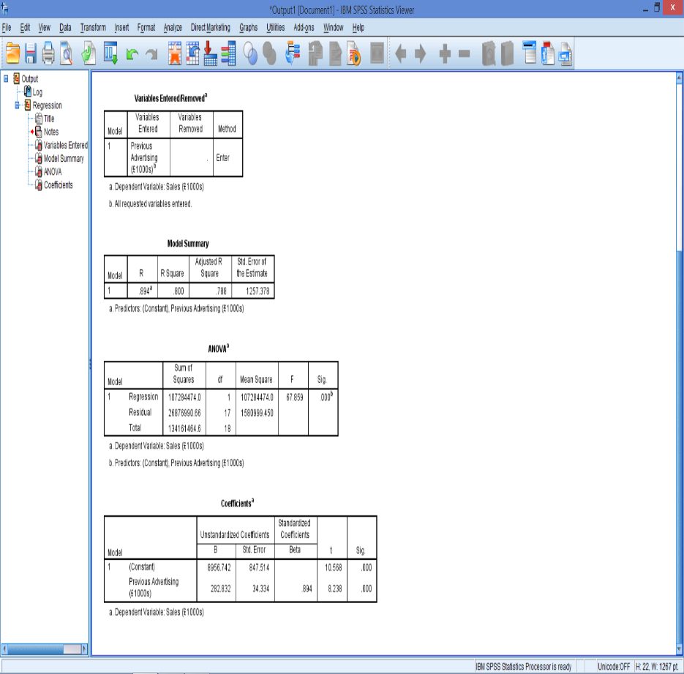
Viewing Output
Correlation
R²
Std. Error of Estimate
TSS
SSE (Residual)
MSE
Estimates
b₀, b₁
Interpretation?
What to add next?
Note: p-value labelled Sig. in SPSS
Notes:
Parameter estimates in column labeled B
Intercept (b₀)
(Constant)
Interpretation: Sales when previous advertising = 0
Slope (b₁)
Previous Advertising
Interpretation: Change in sales when previous advertising changes by one unit

Slide 9
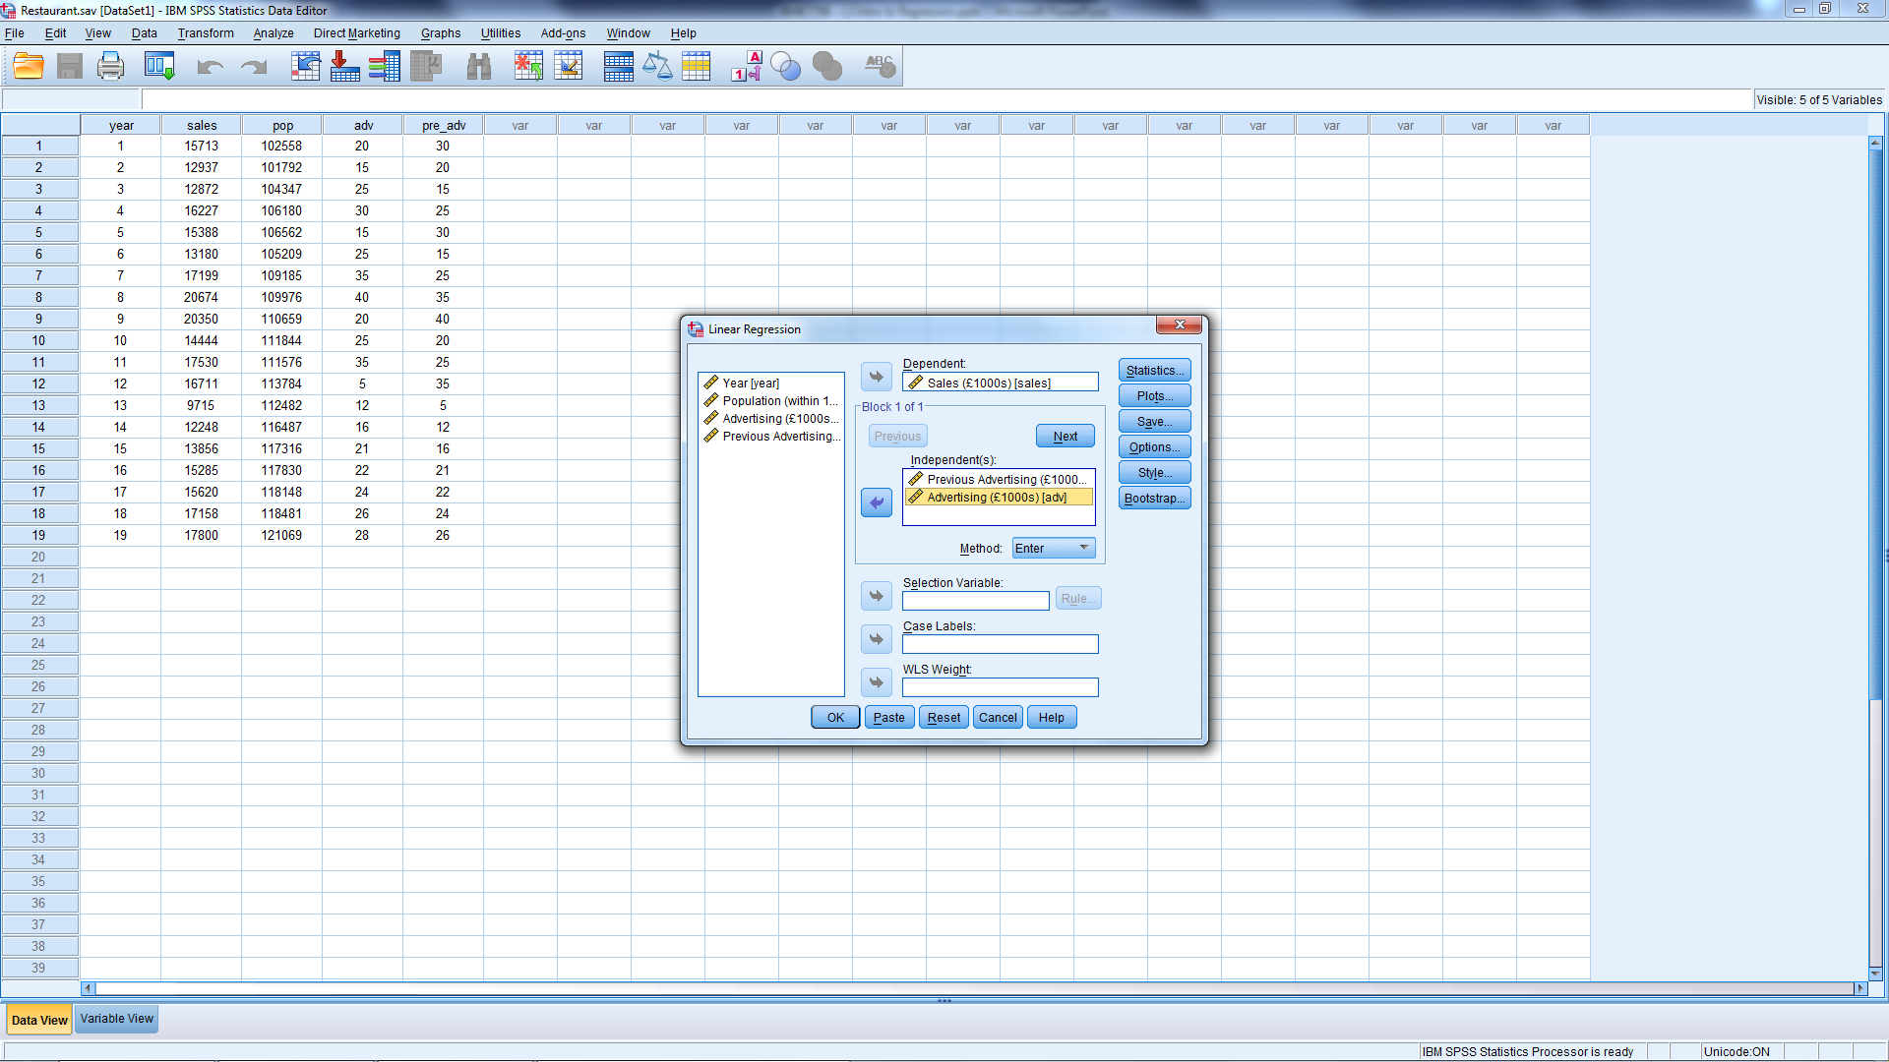
Add Current Advertising
Notes:
Analyze
Regression → Linear
Specify Model w/ arrows
Dependent variable: Sales
Independent variables
Prev adv
Adv
Method = Enter
OK

Slide 10
How the Extra Proviso works
Average Restaurant Sales (Dependent Variable) |  | Previous Advertising
 |  | 5 | …….. | 40
Adv | 5
 | : :
 | 40
Calculates average sales with every combination of previous advertising and current advertising
Will see how sales change
As prev adv changes, keeping adv constant in each row
As adv changes, keeping prev adv constant in each column
Notes:
This is just a bit of intuition behind the calculations.
Note that this becomes a 3 dimensional table with 3 independent variables, 4 dimensional with 4 variables, etc.
The key points are:
We want lots of observations so that
every cell (combination) has some representation
the averages within each cell (combination of advertising and current advertising) are as good as possible
This is why the extra proviso is very important, the calculation of any parameter depends on what other variables are included

Slide 11
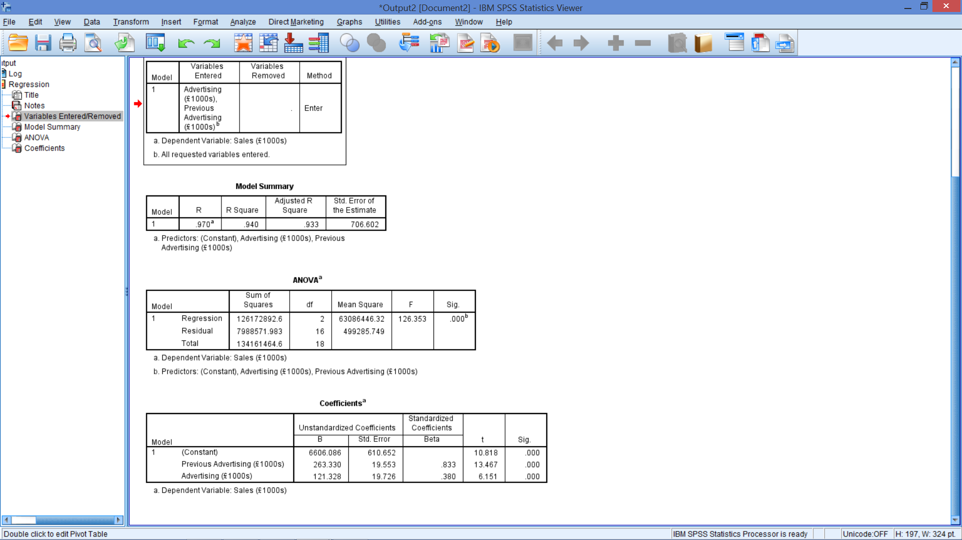
Regression Output

Slide 12
Statistics
Regression Output

Slide 13
R²
R² went from .800 (simple) to .940 (multiple)
R² never decreases with more variables
Need a modified measure of R²
Indicates if an unhelpful variable is added
Accounts for
# Independent variables (including the intercept)
Sample size (N)
Notes:
R² never decreases with more variables
Even if the variable has little relationship with Y
Can be misleading when comparing regressions
Need a modified measure of R²
Indicates when an unhelpful variable is added
Accounts for
# Independent variables being estimates (including the intercept)
This is how large (or how many dimensions in) the previous table
Sample size (N)
How thinly we are spreading our data over the table from the previous slide

Slide 14
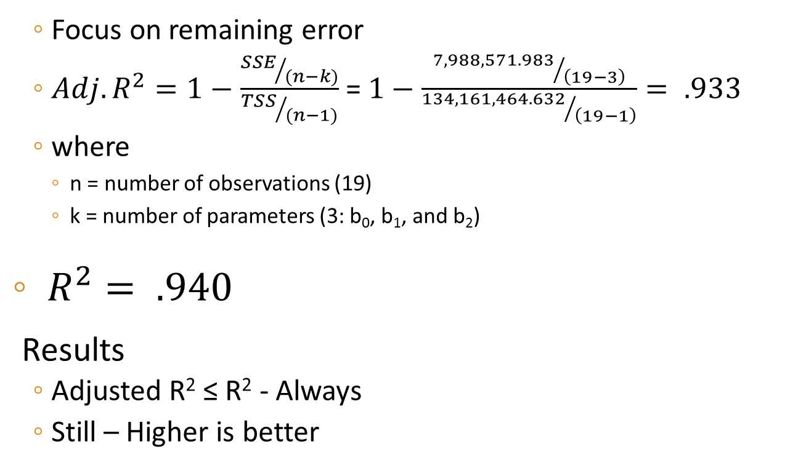
Accounting for N and Parameters Adjusted R²: Is this a good / better model?
Focus on remaining error
$Adj. R^{2}=1−\frac{{SSE}/{(n−k)}}{{TSS}/{(n−1)}}$ =$1−\frac{{7,988,571.983}/{\left(19−3\right)}}{{134,161,464.632}/{\left(19−1\right)}}= .933$
where
n = number of observations (19)
k = number of parameters (3: b₀, b₁, and b₂)
$R^{2}= .940$
Results
Adjusted R² ≤ R² - Always
Still – Higher is better
Notes:
Based on the formula:
When an additional variable is added to the model, k increases by 1
If SSE stays the same (no additional explanatory power added by the variable)
The numerator increases
Since the denominator stays the same, the fraction increases
Subtracting this from 1, leads to a reduction in the Adjusted R²
Need a reduction in SSE that is sufficiently large to keep the numerator from increasing

Slide 15
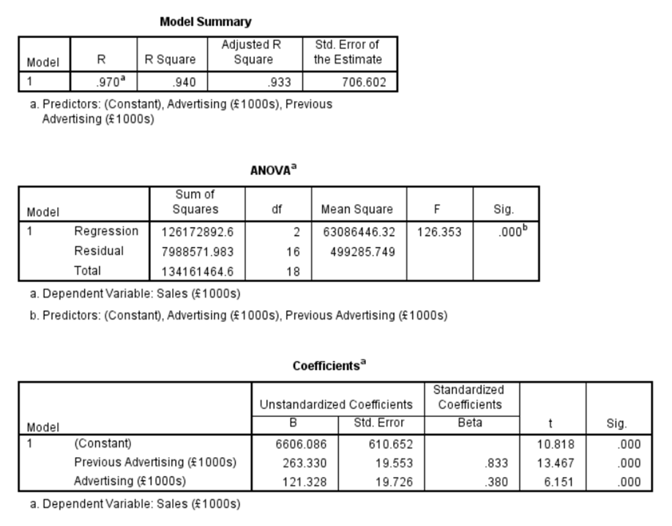
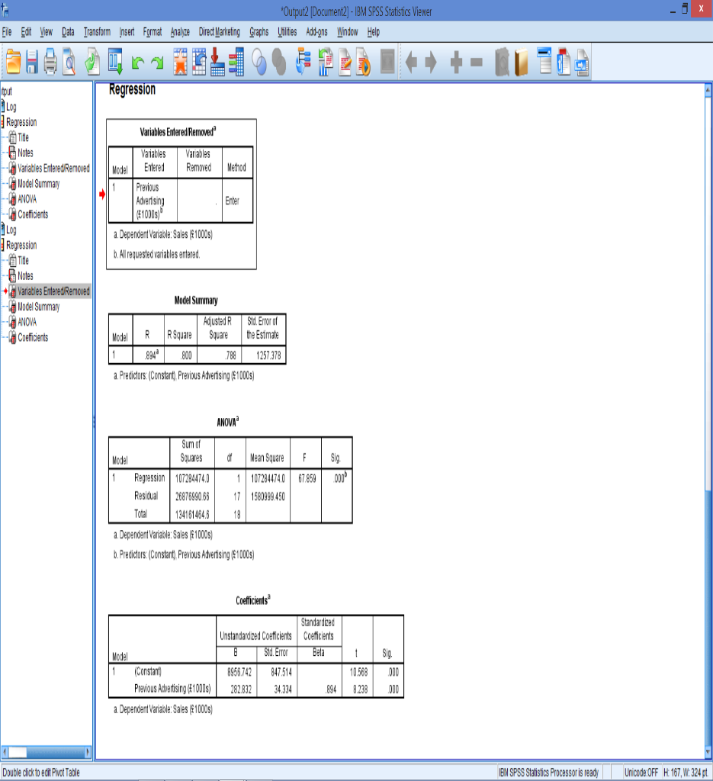
R² Versus Adjusted R²
Notes:
R²:
An additional variable will not decrease R²
Be wary of choosing a model because of a high R²
Adjusted R² : As the number of variables increases
The Adjusted R² is increasingly less than the R²
Adjusted R² can be negative
For comparing 2 models
Must compare models with same dependent variable
Many try to simply maximize Adjusted R²
Think about logical & theoretical relevance of variables
Adjusted R²
If High --- good
If Lower ---- not necessarily bad
R² went from .800 (simple regression) to .940
Adj. R² went from .788 (simple regression) to .933

Slide 16
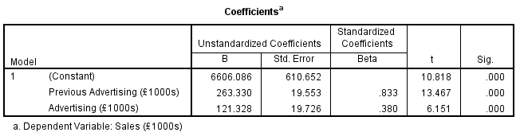
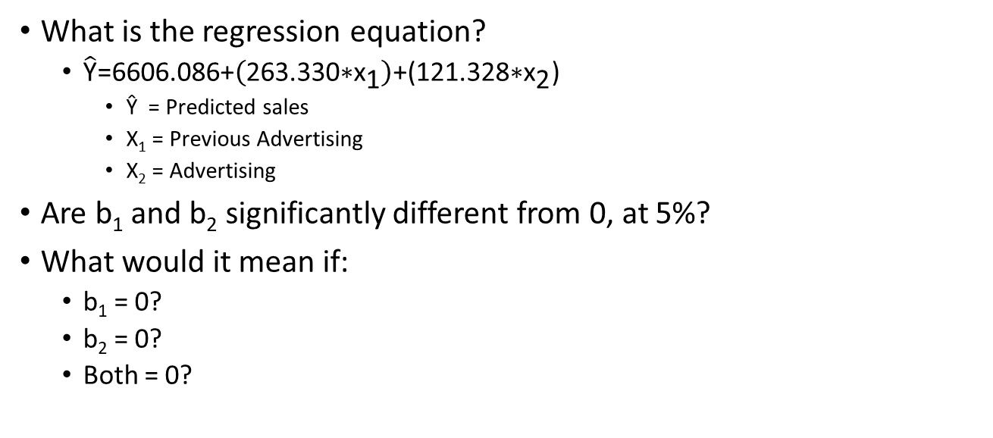
Regression Output - Coefficients
What is the regression equation?
$\hat{\text{Y}}\text{=6606.086+}\left(\text{263.330∗}{\text{x}}_{\text{1}}\right)\text{+(121.328∗}{\text{x}}_{\text{2}}\text{)}$
Ŷ = Predicted sales
X₁ = Previous Advertising
X₂ = Advertising
Are b₁ and b₂ significantly different from 0, at 5%?
What would it mean if:
b₁ = 0?
b₂ = 0?
Both = 0?

Slide 17
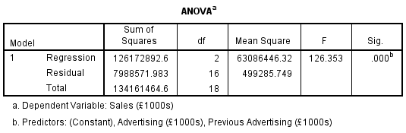
The F-Statistic
Question: Is there something useful in the model?
Before accepting any model, F must be significant
H₀: b₁ = b₂ = … = b_{n} = 0
H₁: At least one b₁, b₂, … b_{n} ≠ 0
Is it significant at 5%?
No relationship between Ind. Vars. & Dep. Var.
At least 1 Ind. Var. helps explain the Dep. Var.
Notes:
H₀: No relationship between Ind. Vars. & Dep. Var.
H₁: At least 1 Ind. Var. helps explain the Dep. Var.
Used to determine if a relationship exists between the dependent variable and the set of independent variables
If sig. there is a relationship with at least one independent variable
Does not tell us which independent variable has the relationship
Before accept new model, F must be significant
Reject H₀?
Yes, if sig. < 0.05
No, if sig. > 0.05
Sig. = .000
Reject H₀
At least one variable (Adv or Prev Adv) is helpful in predicting sales

Slide 18

Quick Review
What is the difference between:
b₀, b₁, … b_{n} and β₀, β₁, … β_{n}?
What is the difference between:
$\hat{y_{i} } \text{and} \overline{y} \text{and} y_{i}$?
What is R²?
What is the difference between:
R² and Adjusted R²?
What is H₀ for:
F-statistic?
t-statistic?

Slide 19

Regression with Adv & Prev Adv
Is there something good in the model?
Is it better than the simple regression?
How do you interpret b₀, b₁ and b₂?
Are they significantly different from 0?

Slide 20

Now Add Population
Why would it make sense to predict sales with population?
Notes:
Analyze
Regression → Linear
Specify Model w/ arrows
Dependent variable
Independent variables
Add: Population
Method = Enter
OK

Slide 21
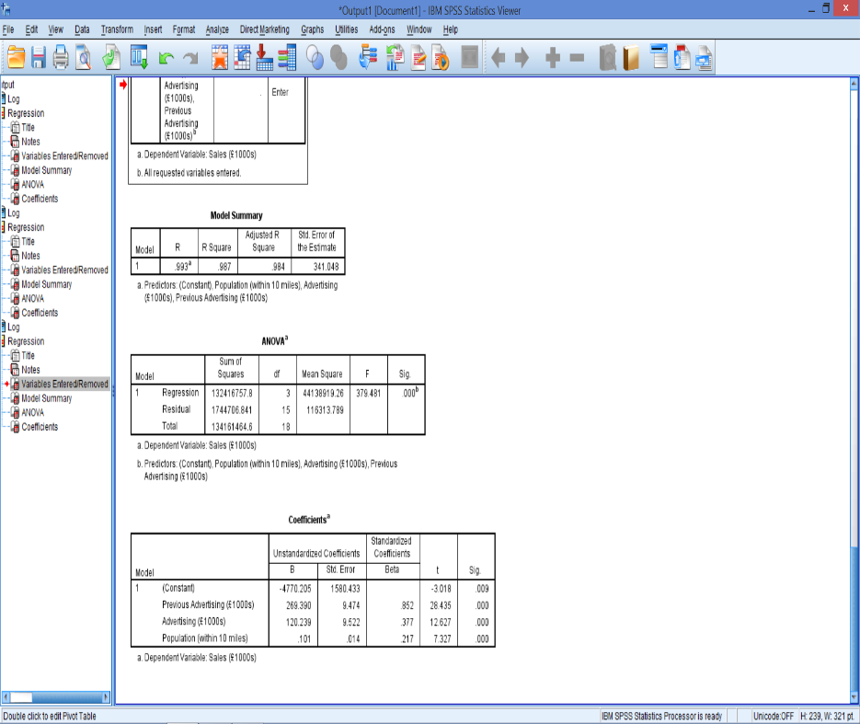
New Output
Is there something good in the model?
Yes
Based on F
Is it a better model?
Yes
Based on Adj. R²

Slide 22
Which regression is best?
 | Newest Variable
 | Prev. Adv. | Adv. | Pop.
Regression Sum of Squares | 107,284,473.98 | 126,172,892.65 | 132,416,757.79
Error Sum of Squares | 26,876,990.66 | 7,988,571.98 | 1,744,706.84
Total Sum of Squares | 134,161,464.63 | 134,161,464.63 | 134,161,464.63
F (sig) | 67.859 (.000) | 126.353(.000) | 379.481(.000)
R² | 0.800 | 0.940 | 0.987
Adjusted R² | 0.788 | 0.933 | 0.984
Notes:
Total sum of squares (TSS) constant across all models
Regression sum of squares (SSR) increasing ⇒ R² increasing
Error sum of squares decreasing
F significant ⇒ There is something useful in each model
Adj. R² increasing ⇒ Each additional variable is helpful
See pages 151 – 152 of Dielman(2005) for a statistical F test to assess whether the improvement in a model is significant.

Slide 23
Which Variables Explain Y?
Ŷ = b₀ + b₁X₁ + b₂X₂ + b₃X₃
X₁ = Previous Advertising
X₂ = Advertising
X₃ = Population
What does it mean if:
Reject H₀: b₁ = b₂ = b₃ = 0 based on F?
b₁ ≠ 0? and/or
b₂ ≠ 0? and/or
b₃ ≠ 0?
Which one?
Question: Is b_{i} significantly different from 0?
Notes:
If we rejected H₀: b₁ = b₂ = b₃ = 0 based on F then we know at least 1 bi ≠ 0.
Which one?

Slide 24
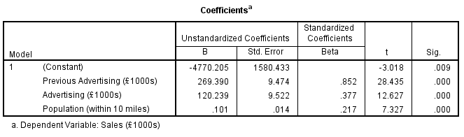
Output: t-statistics
B for Population
Looks like a very small number
Question: Is it significantly different from 0?

Slide 25
Output: t-statistics
t-test for single mean built in
For X₃ = population
H₀: b₃ = 0
H₁: b₃ ≠ 0
Do we reject H₀?
Yes, significantly different from 0 at 5%
This implies that the variable helps explain Y
Notes:
You cannot look at the size of the estimated parameter to see if it is different from 0.
Because of the units (population versus £1000s) the parameter may look small
But, looking at the t-statistic and Sig. indicates that this variable is significant in predicting sales at the restaurant, in the presence of advertising and previous advertising.

Slide 26
Compare Coefficients
Coefficients | Newest Variable
 | Previous Advertising | Advertising | Population
Previous Advertising | 282.832 | 263.330 | 269.390
Advertising |  | 121.328 | 120.239
Population |  |  | 0.101
New coefficients would change predictions
Very important to include correct variables
Why Extra Proviso is present

Slide 27
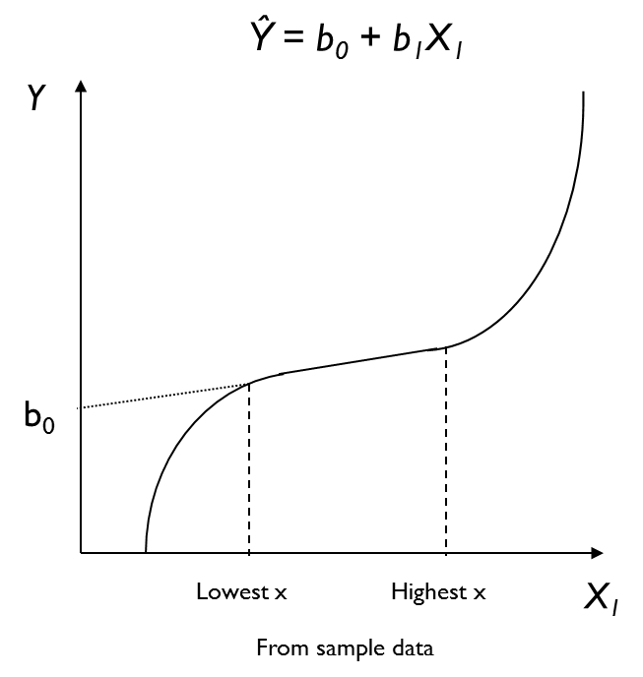
Caution: Interpreting Parameters
Intercept: b₀
In words?
Does this make sense?
Maybe – but we don’t know
This is the line we estimated
Notes:
Remember, b₀ is an anchor that places the line someplace in the plane.

Slide 28
Caution: Interpreting Parameters
Intercept: b₀
In words?
Does this make sense?
No – X₁ can not = 0
Slopes: b₁
Interpretation, in words?
If significant:
Does not mean a causal relationship exists
Does not mean entire relationship is linear
The equation applies
ONLY to this part
of the curve.
Notes:
What if the actual (true in population) relationship looked like this?
Intercept:
b₀
Estimate with all X_{i} = 0 may not be reasonable
Intercept
The predicted value of Y when all X_{i}’s = 0
Sometimes
An artifact of computations
All X_{i}’s = 0 is not a possibility

Slide 29
Predictions
Ŷ= -4770.205 + 269.390(X₁) + 120.239(X₂) + 0.101(X₃)
Ŷ = Predicted sales
X₁ = Previous Advertising
X₂ = Current Advertising
X₃ = Population
Substitute given values of x_{i} into the equation
Forecast from values from range of sample data
Focus on interpreting coefficients
Intercept not always sensible
Notes:
Substitute values of x_{i} from range of x_{i}’s used for estimating the model
Slope (b_{i})
Change in prediction of Y when X_{i} changes by 1 unit
And “the other X’s remain constant”
Cautions
Predictions are best with values from the range of explanatory variables (sample values)
Watch units when making comparisons:
Some may look small but be significant
Some may look large but not be significant
May want to re-estimate equation w/o insignificant variables – changes coefficients

